Slide 1
Introduction Designing Classes Prelude
Manar Mohamed
mohamem@miamioh.edu

Slide 2
Homework:
PalBook social network
Does not require any 274 material, but it is related to ideas we will talk about
Builds on ideas from CSE 174, 271
Arrays and/or ArrayLists
Follow specifications

Slide 3
Homework
Amy
Bob
Fred
Erin
Cam
Dan
We might implement our PalBook graph using:
a 2-D array
an arraylist of "Member" objects, where each member has its own arraylist of members who are pals

Slide 4
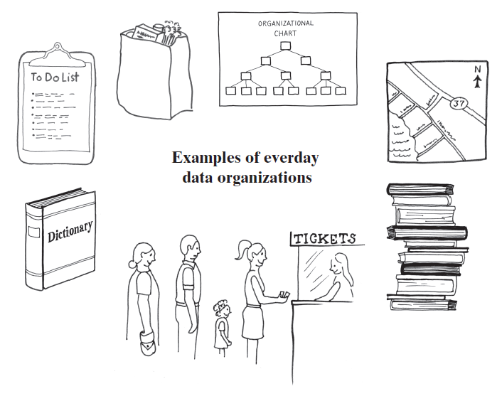
Data Organization in Life
© 2015 Pearson Education, Inc., Upper Saddle River, NJ. All rights reserved.
Notes:
Standing in a line
Stack of books
To-Do list
Dictionary
Folders, directories on your computer
Road map

Slide 5
Abstract Data Type (ADT)
Abstract Data Type
A model that describes/specifies a collection of data and the behaviors on that data
Each ADT specifies what data is stored and what the operations on the data do
Not specific to any programming language
From the point of view of the user
Sometimes includes information about behavior if something goes wrong
Sometimes includes information about performance (efficiency)
© 2015 Pearson Education, Inc., Upper Saddle River, NJ. All rights reserved.

Slide 6
Computer Data Organization
Abstract Data Type (ADT): a specification that describes a data set and the operations on that data
Data Structure: an implementation of an ADT within a programming language
Collection: a general term for an ADT that contains a group of objects. Some collections allow duplicate items, some do not. Some collections arrange their contents in a certain order, while others do not.
Container: a class that implements a collection
Bag, List, Stack, Queue, Dictionary, Tree, Graph
`

Slide 7
Lists
What are they, from a non-programmer's perspective?
Can you describe what they are from a high level?
What are the things we would like to be able to do with a list?
Add items
Remove items
Remove a particular item
Remove all items
See if an item is there
Find out the position of an item
Find out if the list is empty

Slide 8
Abstract Data Type (ADT)
List example:
A list is an ordered collection of items that may be repeated. It will let us:
Add items
Remove items
Find the position of an item
Or, maybe there are even more behaviors we want our list to have:
Sort the items
Count the items
Count occurrences

Slide 9
Is a list an array?
No. But…
...you ought to be able to imagine implementing the ADT in Java using an array.
But…
...there are other ways to implement the list ADT without using an array.

Slide 10
What if you want a programmer to implement a list?
You need to get more specific about the behaviors:
Could use a CRC card: Class Responsibility Collaborator card
Could use a UML diagram
Could use a Java interface

Slide 11
Class Responsibility Collaborator (CRC) Card
List
Responsibilities
Get the number of items currently in the list
See whether the list is empty
Add a given object to the list
Remove a particular object from the list, if possible
Find the position of a certain object in the list
Count the number of times a certain object occurs in the list
Test whether the bag contains a particular object
Convert the list to an array
Collaborations
The class of objects that the list can contain

Slide 12
Using UML Notation to Specify a Class
List
+getCurrentSize(): integer +isEmpty(): boolean +add(newEntry: T): boolean +remove(anEntry: T): boolean +getFrequencyOf(anEntry: T): integer +indexOf(anEntry: T): integer +count(anEntry: T): int +contains(anEntry: T): boolean +toArray(): T[]

Slide 13
Interfaces
public interface List<E> {
public void add(E item);
public void remove(E item);
...
}
Then, a programmer who wants to implement list must include all of the methods in the interface.

Slide 14
List, ArrayList, LinkedList
In Java:
List is an Interface
ArrayList and LinkedList are two different implementations of List.
Why have two?

Slide 15
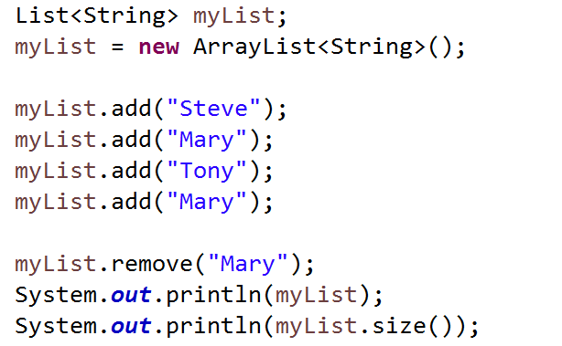
Observe
List is an interface. ArrayList implements the List interface.

Slide 16
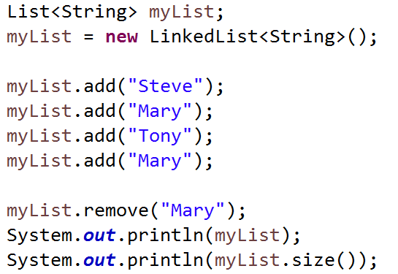
Observe again
The only change below is that we switched to LinkedList. The code still works because LinkedList also implements the List interface.

Slide 17
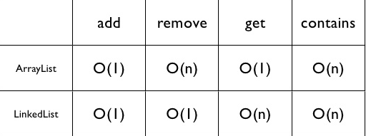
ArrayList vs LinkedList Performance

Slide 18
What will you learn in CSE 274?
Begin with an Abstract Data Type. With it:
Write the interface.
Write multiple implementations of that interface.
Sometimes array-based implementations
Sometimes linked-list based implementations
Sometimes other implementations
Compare implementations with regard to efficiency
Which one is faster for searching?
Which one is faster for adding and deleting items?
Which one uses less memory to implement sorting?

Slide 19
Abstract Data Types you should learn:
Bags
Lists
Sets
Stacks
Queues
Priority Queues
Dictionaries
Maps
Tables
Trees
Graphs

Slide 20
Designing Classes
Prelude

Slide 21
Object Oriented Programming
Design concepts:
Inheritance
Polymorphism
Encapsulation

Slide 22
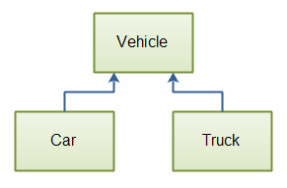
Inheritance
Inheritance allows us to define a general class and then later to define more specialized classes that add to or revise the details of the older, more general class definition.

Slide 23
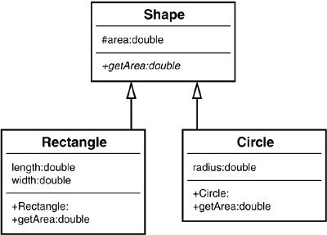
Polymorphism
Polymorphism allows the same program instruction to mean different things in different contexts.
In particular, one method name, used as an instruction, can cause different actions depending on the kind of object performing the action.

Slide 24
Encapsulation
Information hiding
Enclose data and methods within a class
Hide implementation details
Programmer receives only enough information to be able to use the class

Slide 25
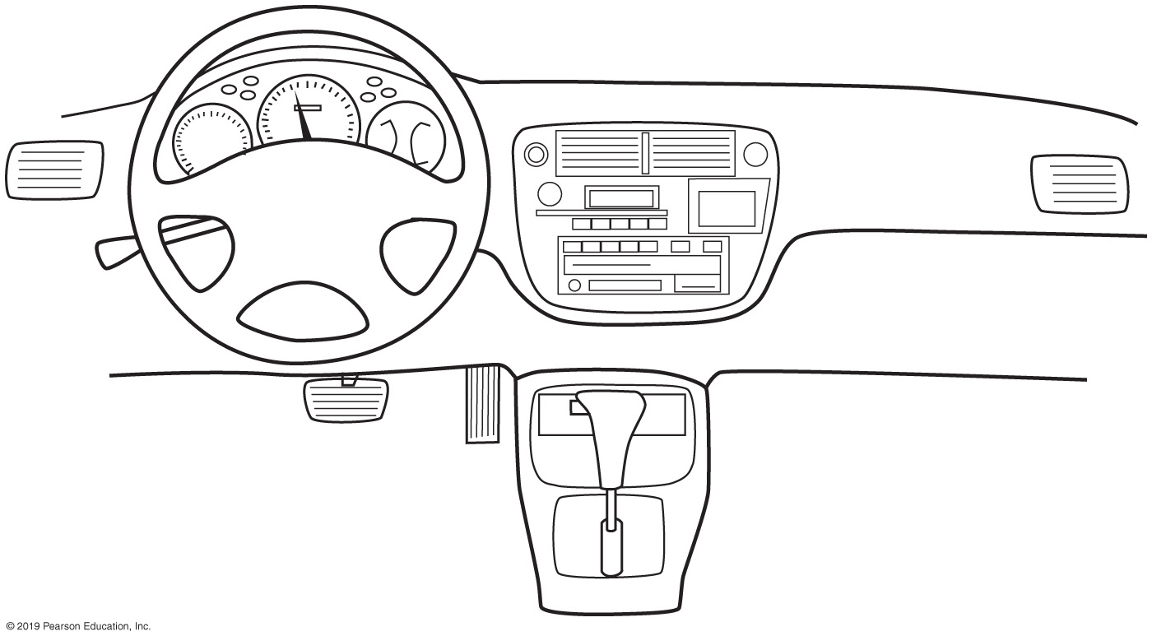
Encapsulation
FIGURE P-1 An automobile’s controls are visible to the driver, but its inner workings are hidden

Slide 26
Abstraction
Focus on what instead of how
What needs to be done?
For the moment ignore how it will be done.
Divide class into two parts
Client interface
Implementation

Slide 27
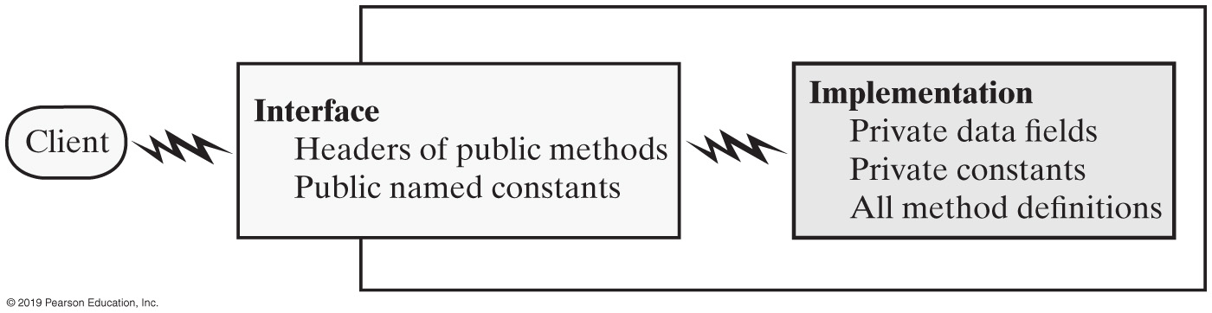
Abstraction
FIGURE P-2 An interface provides well-regulated communication between a hidden implementation and a client

Slide 28
Specifying Methods
Preconditions
What must be true before method executes
Implies responsibility for client
Postconditions
Statement of what is true after method executes
Use assertions
In comments or with assert statement

Slide 29
Example of Precondition
/** Computes the square root of a number. @param x a real number >= 0
@return the square root of x
*/
assert x >= 0;

Slide 30
Java Interfaces
Program component that declares a number of public methods
Should include comments to inform programmer
Any data fields here should be public, final, static

Slide 31
Interface Measurable
/**
An interface for methods that return
the perimeter and area of an object.
*/
public interface Measurable
{
/** Gets the perimeter.
@return The perimeter. */
public double getPerimeter();
/** Gets the area.
@return The area. */
public double getArea();
} // end Measurable
Listing 2-1

Slide 32
Programming Tip:
A Java interface is a good place to provide comments that specify each method’s purpose, parameters, precondition, and postcondition. In this way, you can specify a class in one file and implement it in another
© 2015 Pearson Education, Inc., Upper Saddle River, NJ. All rights reserved.

Slide 33
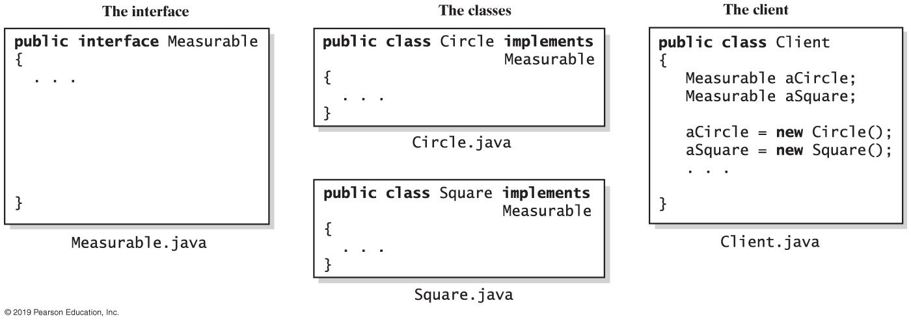
Implementing an Interface
FIGURE P-3 The files for an interface, a class that implements the interface, and the client

Slide 34
Implementing an Interface
A way for programmer to guarantee a class has certain methods
Several classes can implement the same interface
A class can implement more than one interface

Slide 35
Interface as a Data Type
You can use a Java interface as you would a data type
Indicates variable can invoke certain set of methods and only those methods.
An interface can be used to derive another interface by using inheritance
© 2015 Pearson Education, Inc., Upper Saddle River, NJ. All rights reserved.

Slide 36
Interface vs. Abstract Class
Purpose of interface similar to that of abstract class
But an interface is not a class
Use an abstract class …
If you want to provide a method definition
Or declare a private data field that your classes will have in common
A class can implement several interfaces but can extend only one abstract class.

Slide 37
Choosing Classes
Consider a registration system for your school …
Issues:
Who, what will use the system?
What can each actor do with the system?
Which scenarios involve common goals?

Slide 38
CSC Card Example
CourseSchedule
Responsibilities
Add a course
Remove a course
Check for time conflict
List course schedule
Collaborations
Course
Student
FIGURE P-6 A class-responsibility-collaboration (CRC) card

Slide 39
Unified Modeling Language Class
CourseSchedule
-courseCount: integer -courseList: List
+addCourse(course) : void +removeCourse(course) : void +isTimeConflict() : Boolean +listSchedule(): void
FIGURE P-7 A class representation that can be a part of a class diagram

Slide 40
UML Interface Example
<<interface>> Measurable
+getPerimeter(): double +getArea(): double
FIGURE P-8 UML notation for the interface Measurable

Slide 41
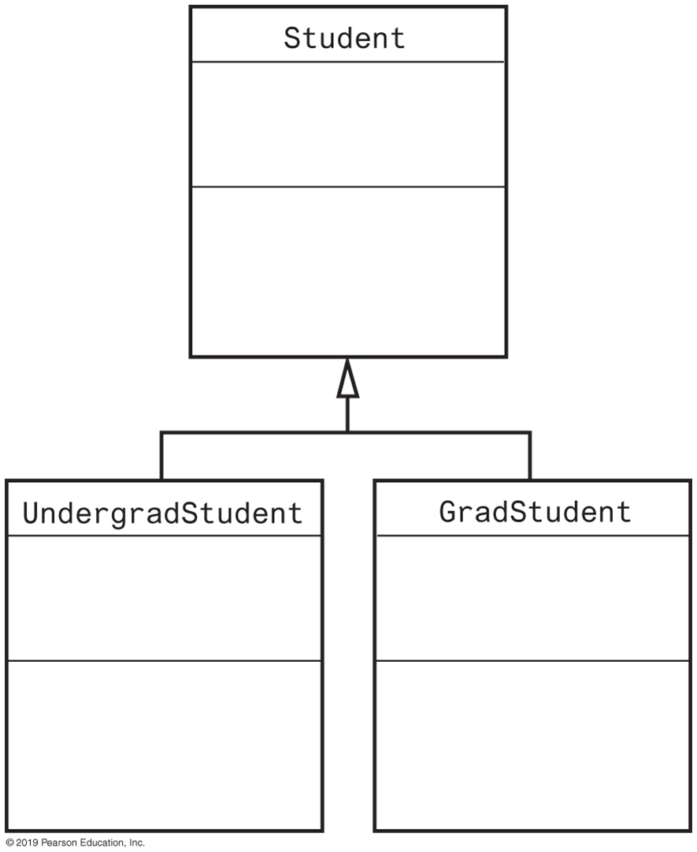
UML Class Hierarchy
FIGURE P-9 A class diagram showing the base class Student and two subclasses

Slide 42
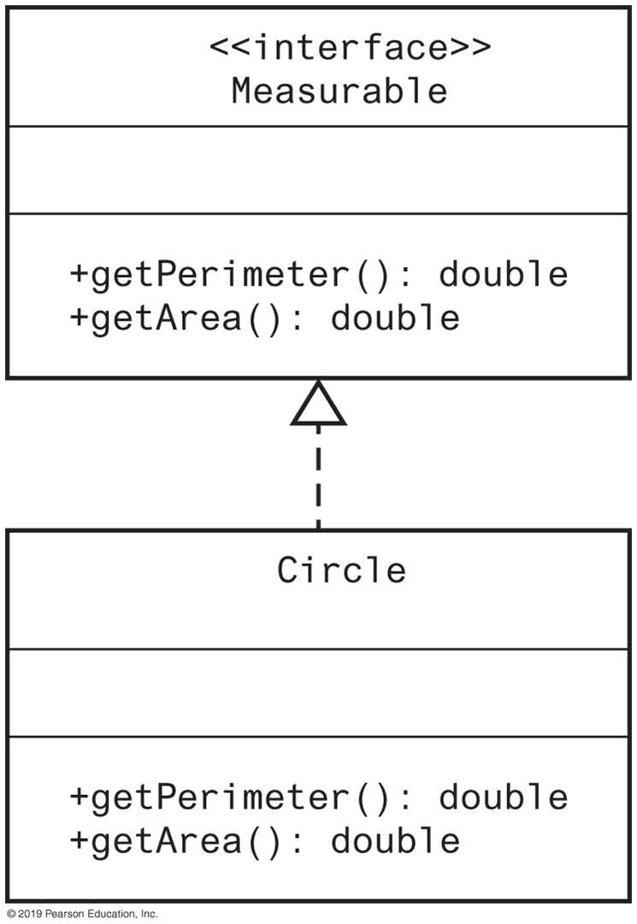
UML Interface Implementation
FIGURE P-10 A class diagram showing the class Circle that implements the interface Measurable

Slide 43
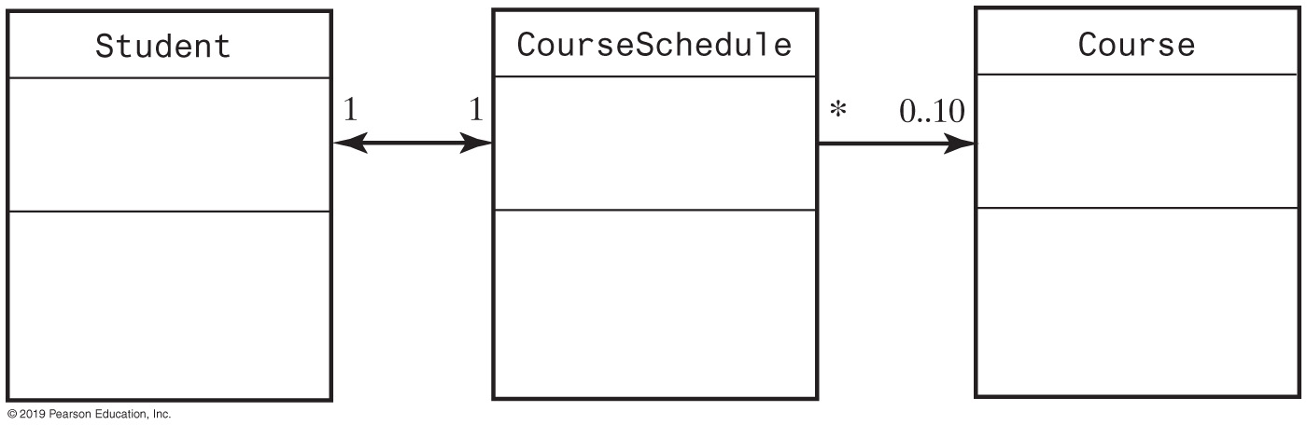
UML Class Associations
FIGURE P-11 Part of a UML class diagram with associations

Slide 44
Reusing Classes
Not all programs designed and written “from scratch”
Actually, most software created by combining
Already existing components with
New components
Saves time and money
Reused components are already tested

Slide 45
Generic Data Types
Enable you to write a placeholder instead of an actual class type
The placeholder is
A generic data type
A type parameter
You define a generic class
Client chooses data type of the objects in collection.

Slide 46
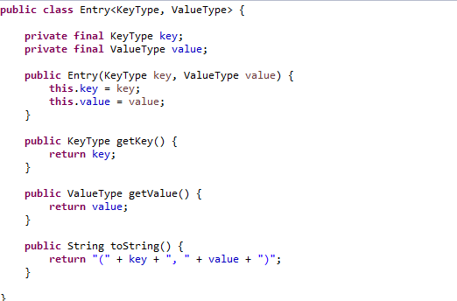
Generic Class

Slide 47


Slide 48
END

